Slide 1
Build Online Sales Application
Nhân bản – Phụng sự – Khai phóng
Instructor: KS.Hoàng Vũ Dạ Quỳnh
Student: Nguyễn Đình Mạnh– 23IT159
Đà Nẵng, 30/11/2024

Slide 2
Introduction
System Analysis And Design
Build Online Sales Application

Slide 3

I. Introduction
Project Objective
Build an Android for online selling
Help sellers manage products, orders, and profiles.
Buyers can browse and place orders
Technologies user: Android, Firebase, Cloudinary

Slide 4

I. Introduction
Why This Topic?
E-commerce is booming
Online selling needs are rising
Aim to provide a simple, effective tool for individual sellers
Opportunity to learn technologies:
- Kotlin
- Firebase
- Cloudinary

Slide 5
I. Introduction
System Overview
Android app (client) connects with:
Firebase Realtime Database – data storage
Cloudinary – image storage

Slide 6
I. Introduction
Key Features
Login/Registration
Product Managent
Order Managent
Profile Editing
Buy Product
Chat

Slide 7
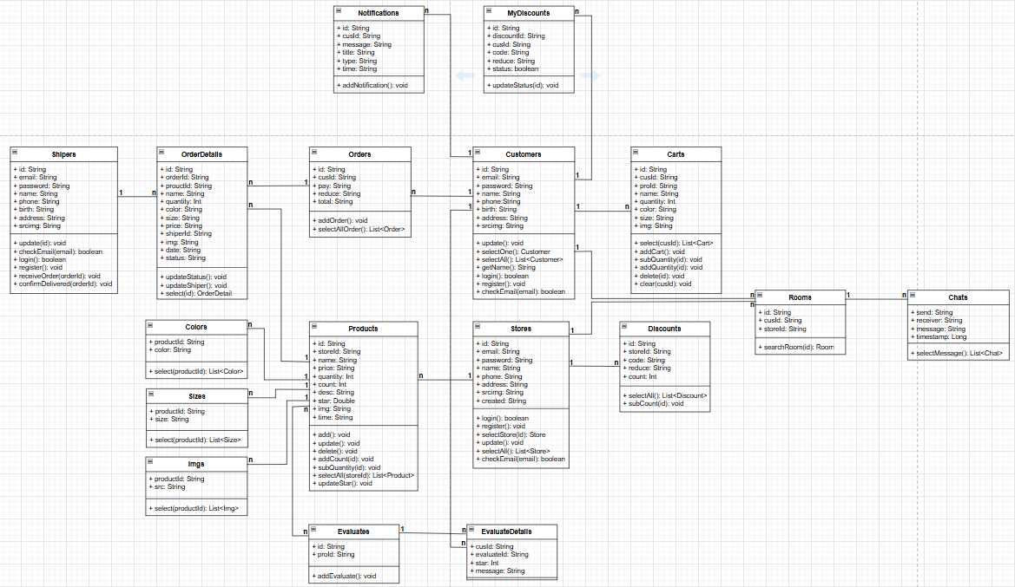
II. System Analysis And Design
Class Diagram

Slide 8
III. Build Online Sales Application
Results & Limitations
Achievements:
- Fully functional Android app
- Clean, friendly UI
- Runs smoothly on real devices
- Learned new tech & teamwork skills
Limitations:
- No payment system yet
Future Plans:
AI product suggestions
Admin web interface
Rating & review system

Slide 9
III. Build Online Sales Application
Show Project

Slide 10

Thank you!
Nhân bản – Phụng sự – Khai phóng

